Slide 1

Face recognition
Face verification and binary classification
deeplearning.ai

Slide 2
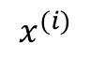

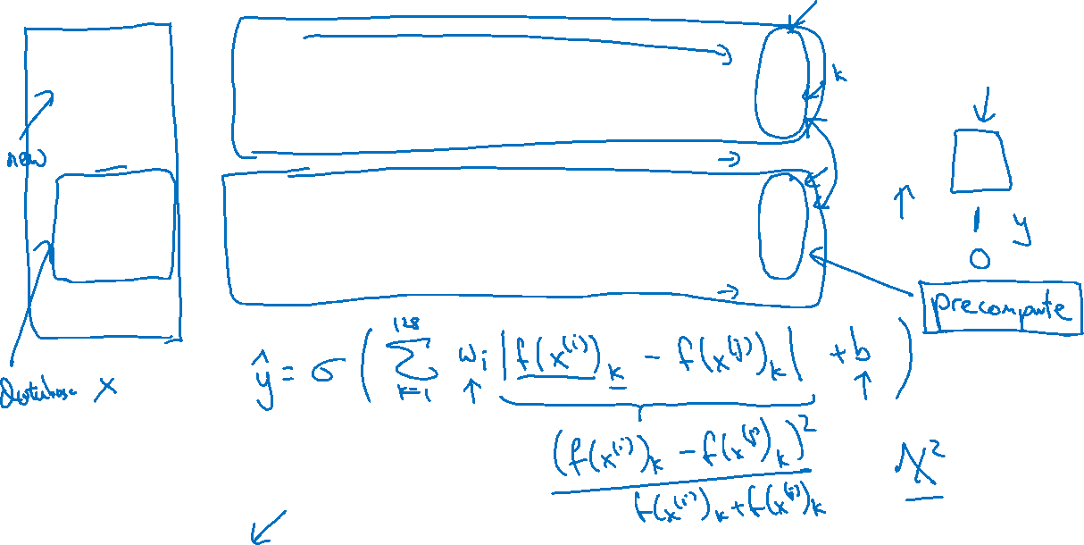
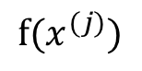

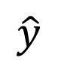
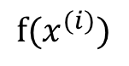
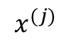
Learning the similarity function
$$⋮$$
$$x^{(i)}$$
$$f(x^{(i)})$$
$$\hat{y}$$
$$⋮$$
$$x^{(j)}$$
$$f(x^{(j)})$$
[Taigman et. al., 2014. DeepFace closing the gap to human level performance]

Slide 3


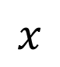




Face verification supervised learning
$$x$$
$$y$$
$$1$$
$$0$$
$$0$$
$$1$$
[Taigman et. al., 2014. DeepFace closing the gap to human level performance]

